Slide 1
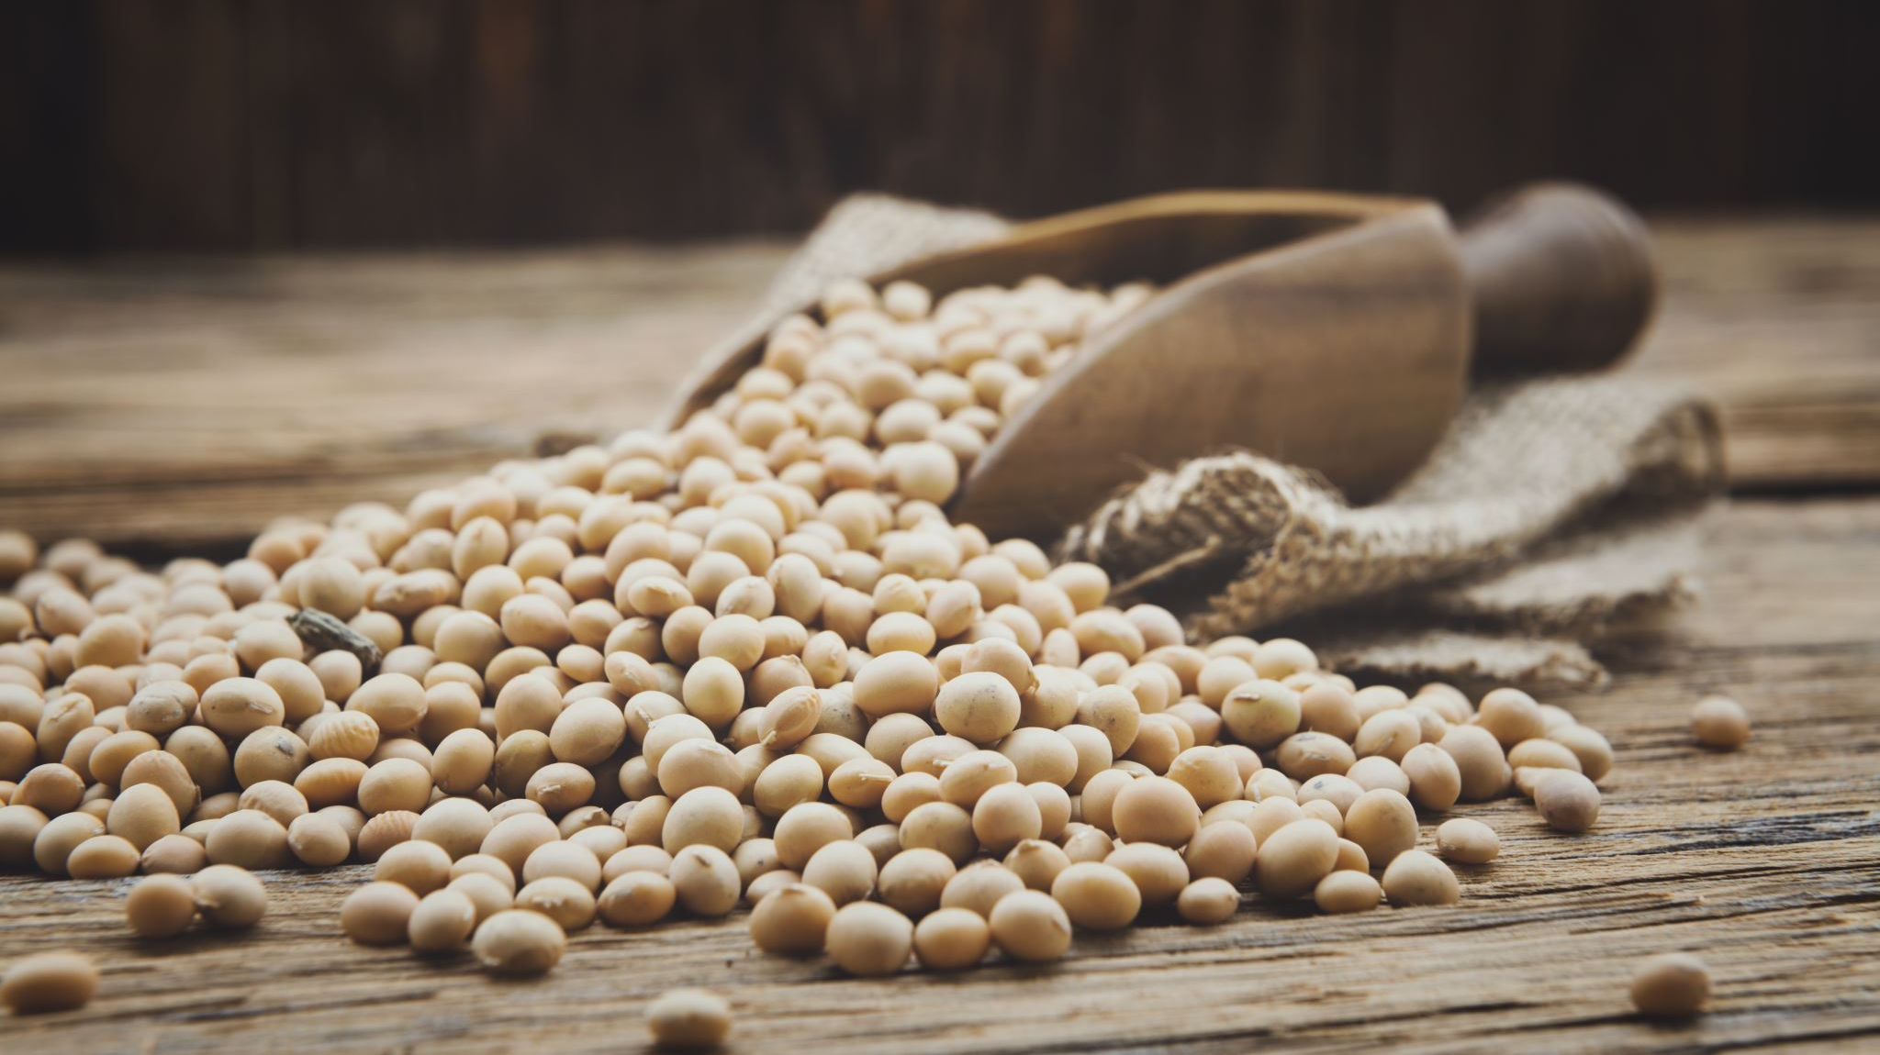
Group 4 -Mustard Seed Assignment 3b
By: Dominic, You Sheng, Shanthal, Yang Jun

Slide 2
Opportunity Statement
How might we relieve stress for students to help them deal better with their stress factors so that they can perform better?

Slide 3
Our Idea
A mobile app because:
1. Large customer pool
2. Enhanced user experience
3. Less friction as downloading easier than
buying

Slide 4
1. Summaries of books 2. Discussion Forum 3. Functionalities
Components of the app

Slide 5
1. Gain new insights from books 2. Forge and deepen connections with others 3. Build good habits
Goals for the app

Slide 6
Feedback 1
1) Have a focus for the app. Inadvisable to focus on too
many features at the same time
2) Adding a dynamic layer for summaries. Make it more
personalized.

Slide 7
Implementation
1) Allow users to publish their own summaries, giving it a
more personalized touch.
2) Encourage users to publish their summaries. By giving
monetary rewards if the summary is popular.

Slide 8
Feedback 2
1) Incentivize users to invite their friends to use the app
2) Incentivize user's friends to download the app
3) User's will have a better time when they can connect with people they
are familiar with through the app.

Slide 9
Implementation
1) Extend the free trial for users who invited their friends
to download the app
2) Users who use a code to join will have a longer free trial

Slide 10
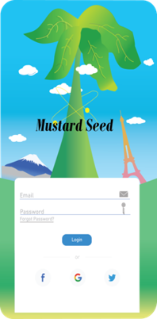
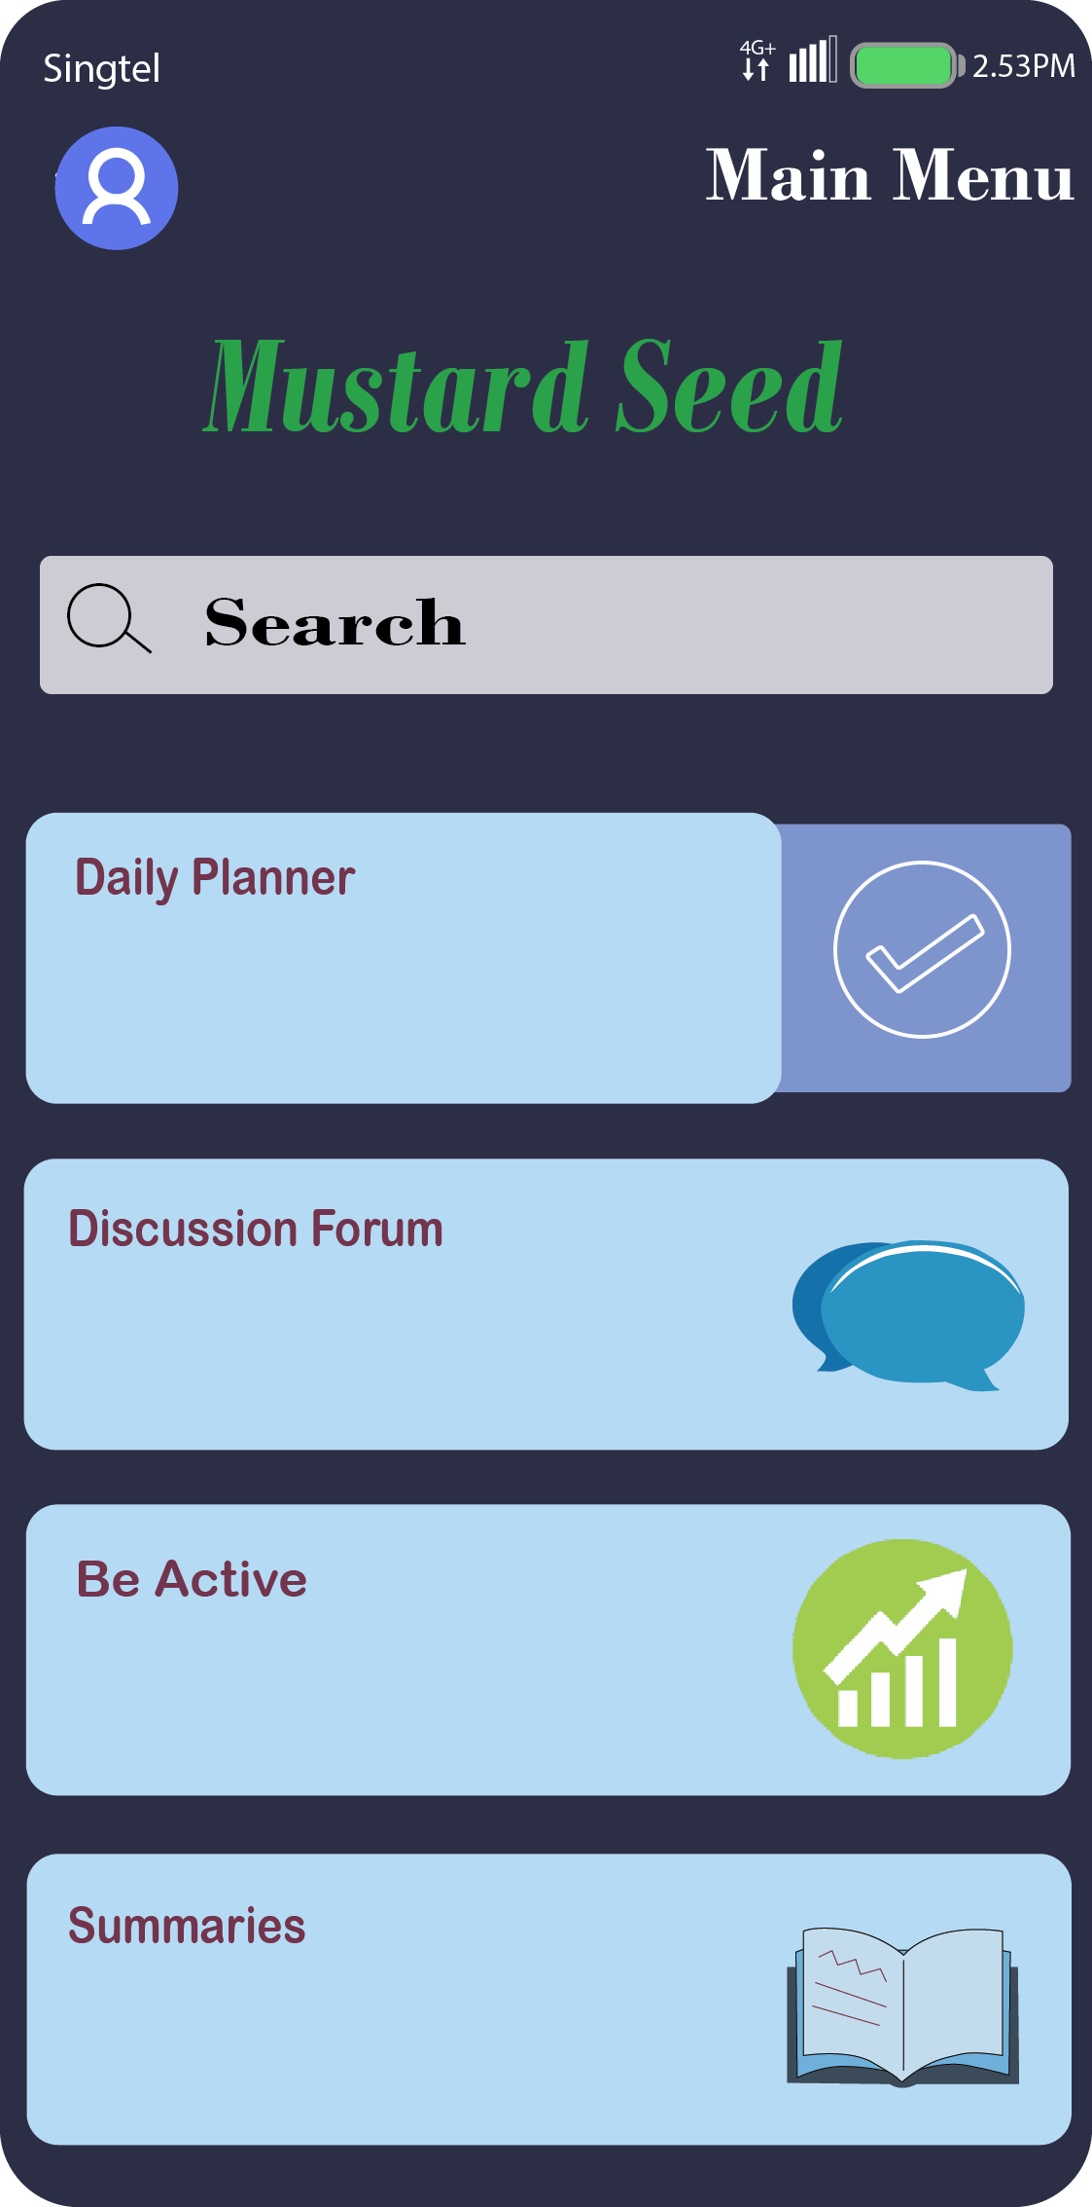
Login Page

Slide 11
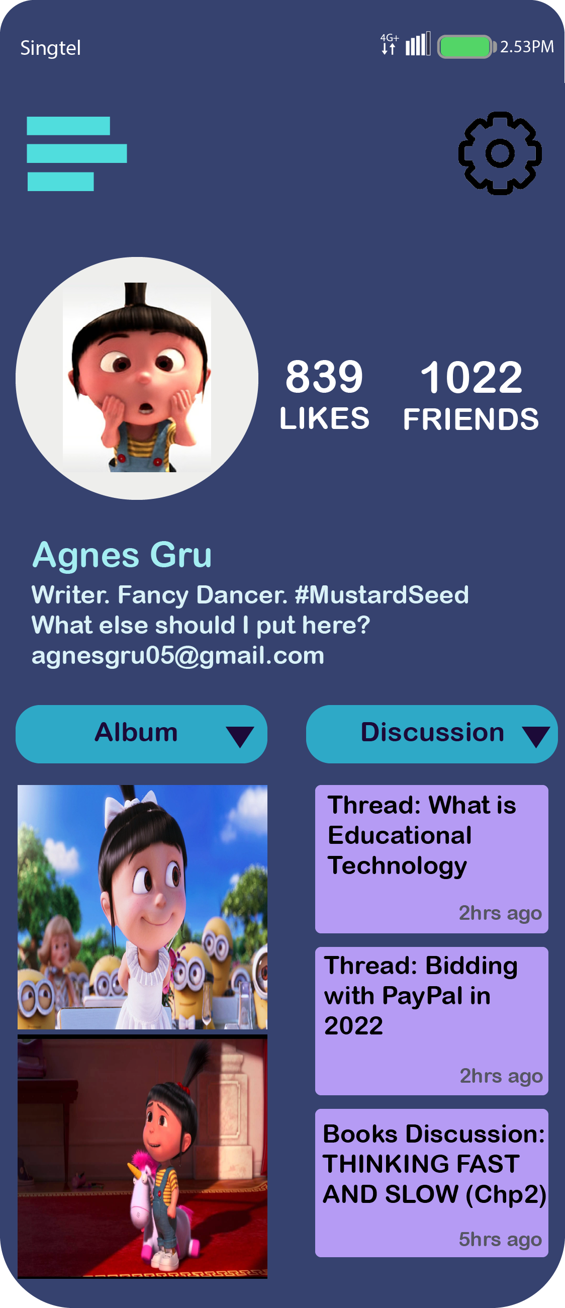
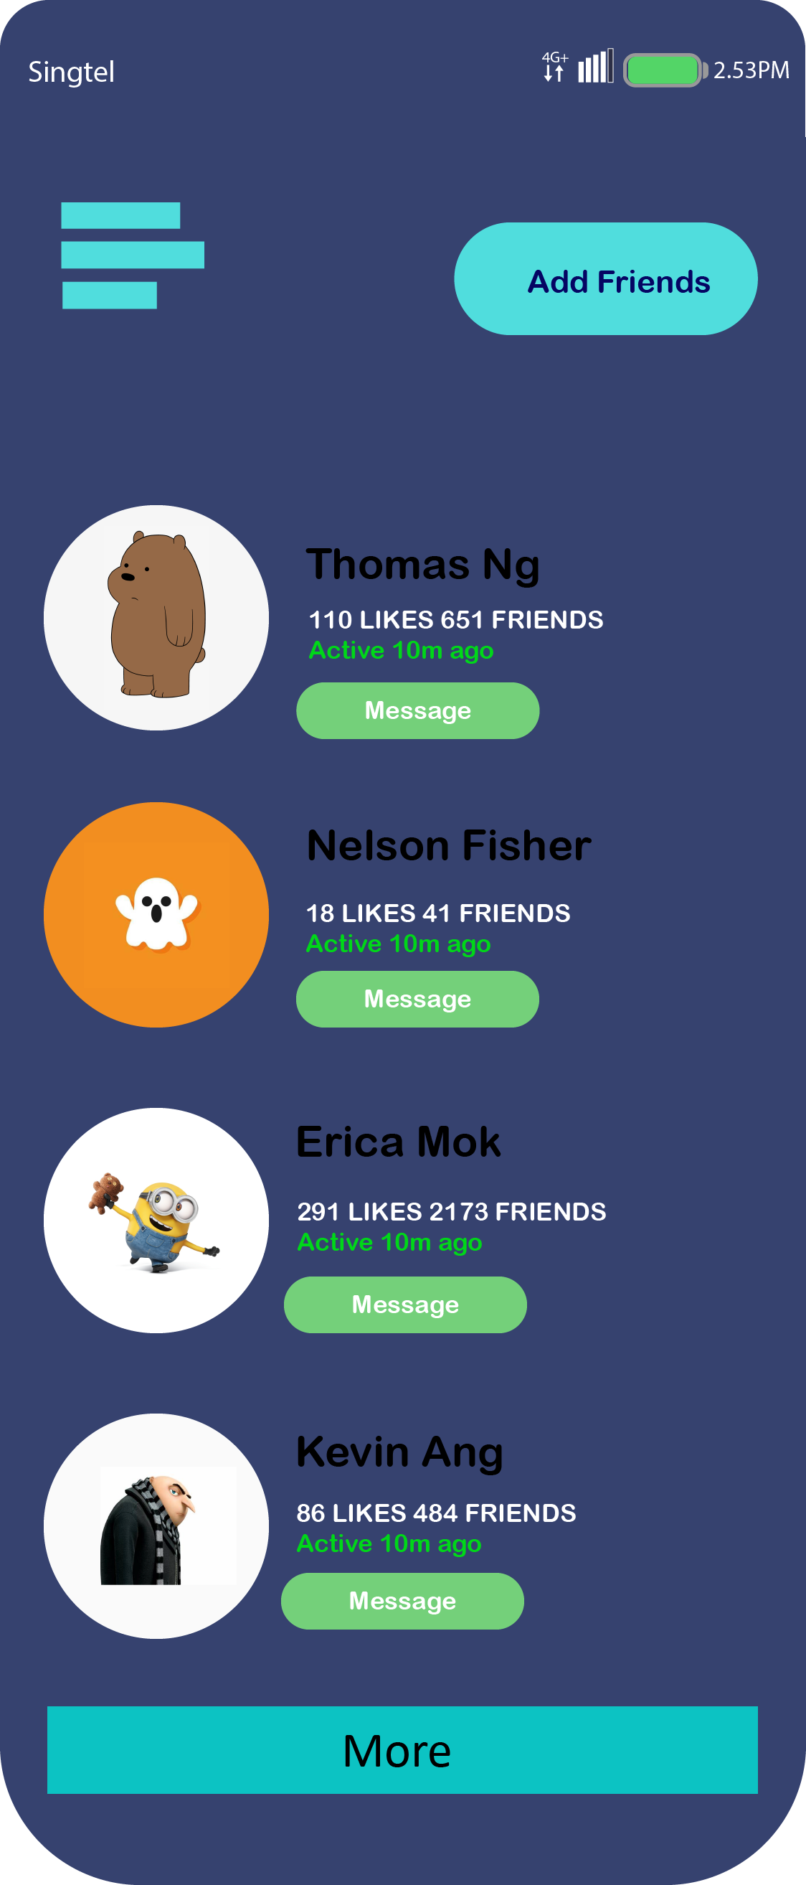
Profile Page

Slide 12

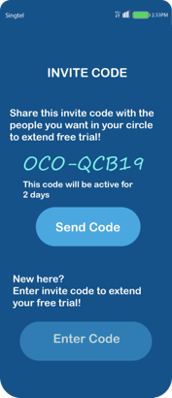
Settings

Slide 13
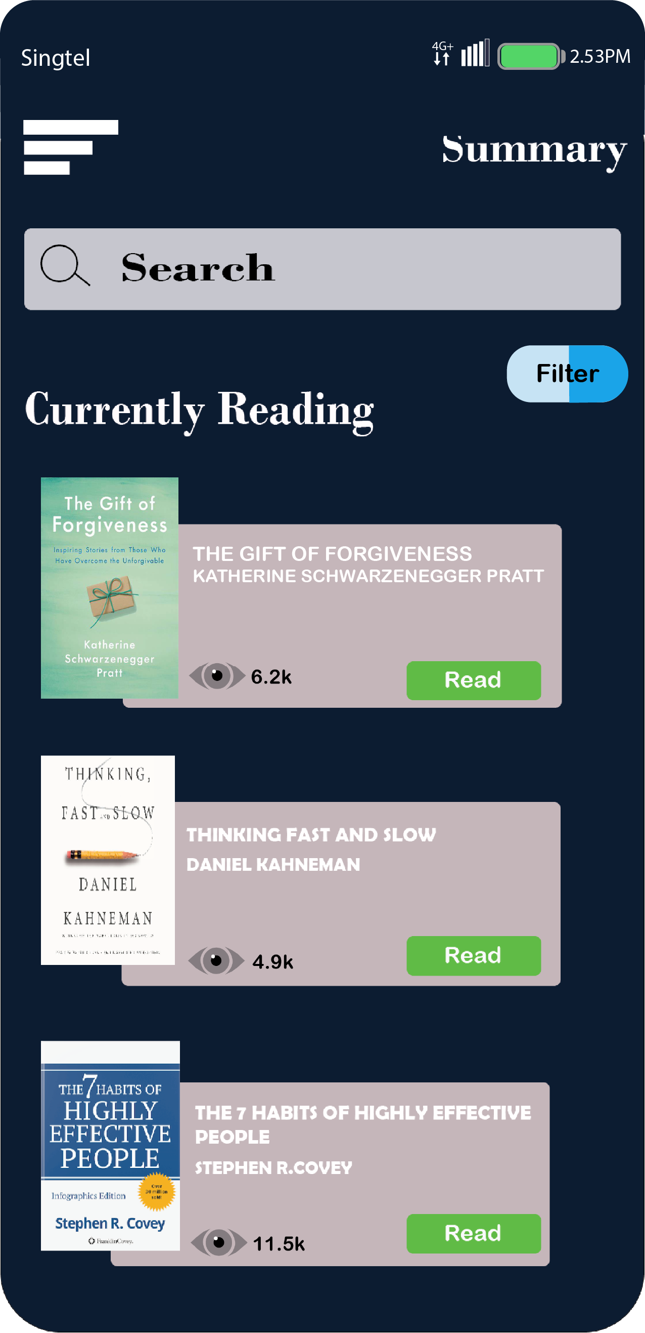
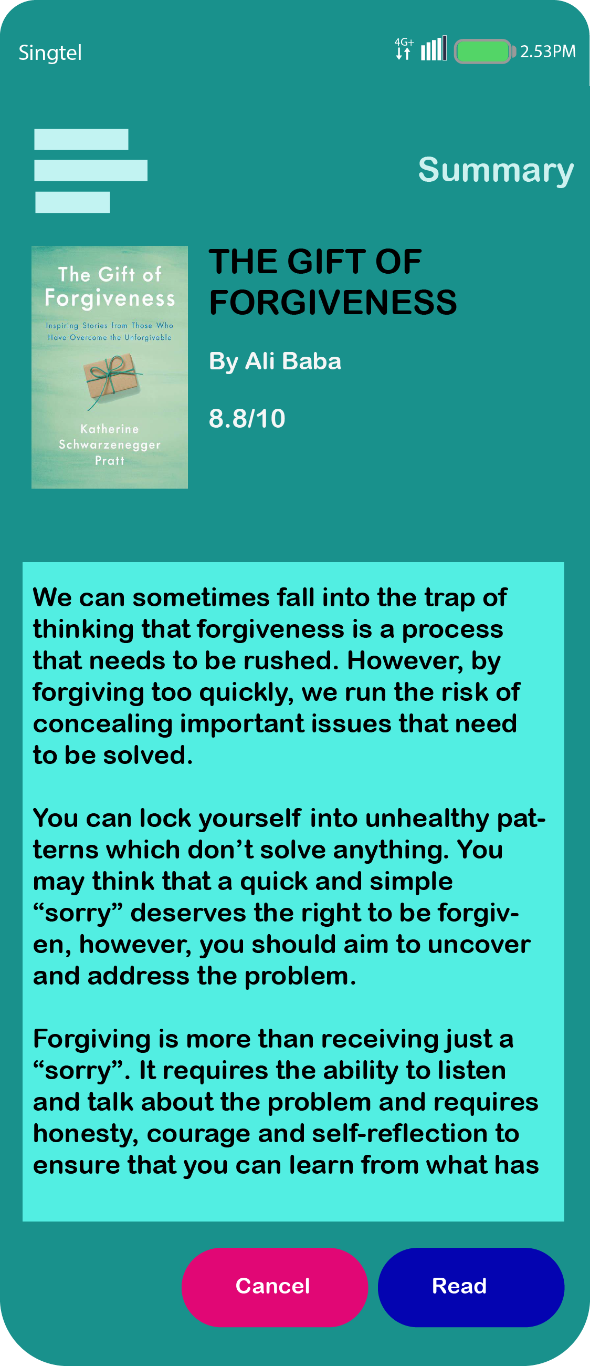
Summaries

Slide 14
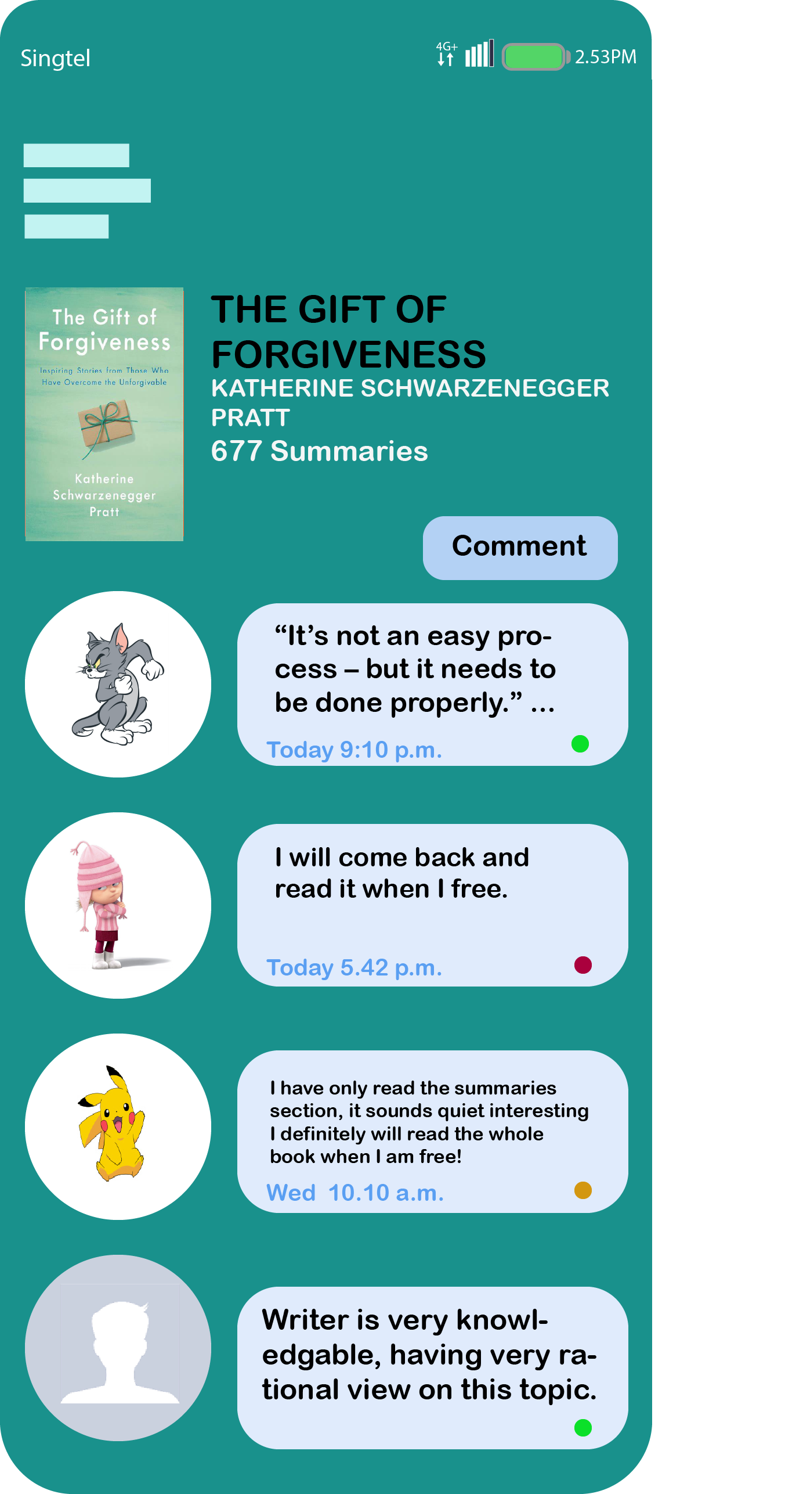
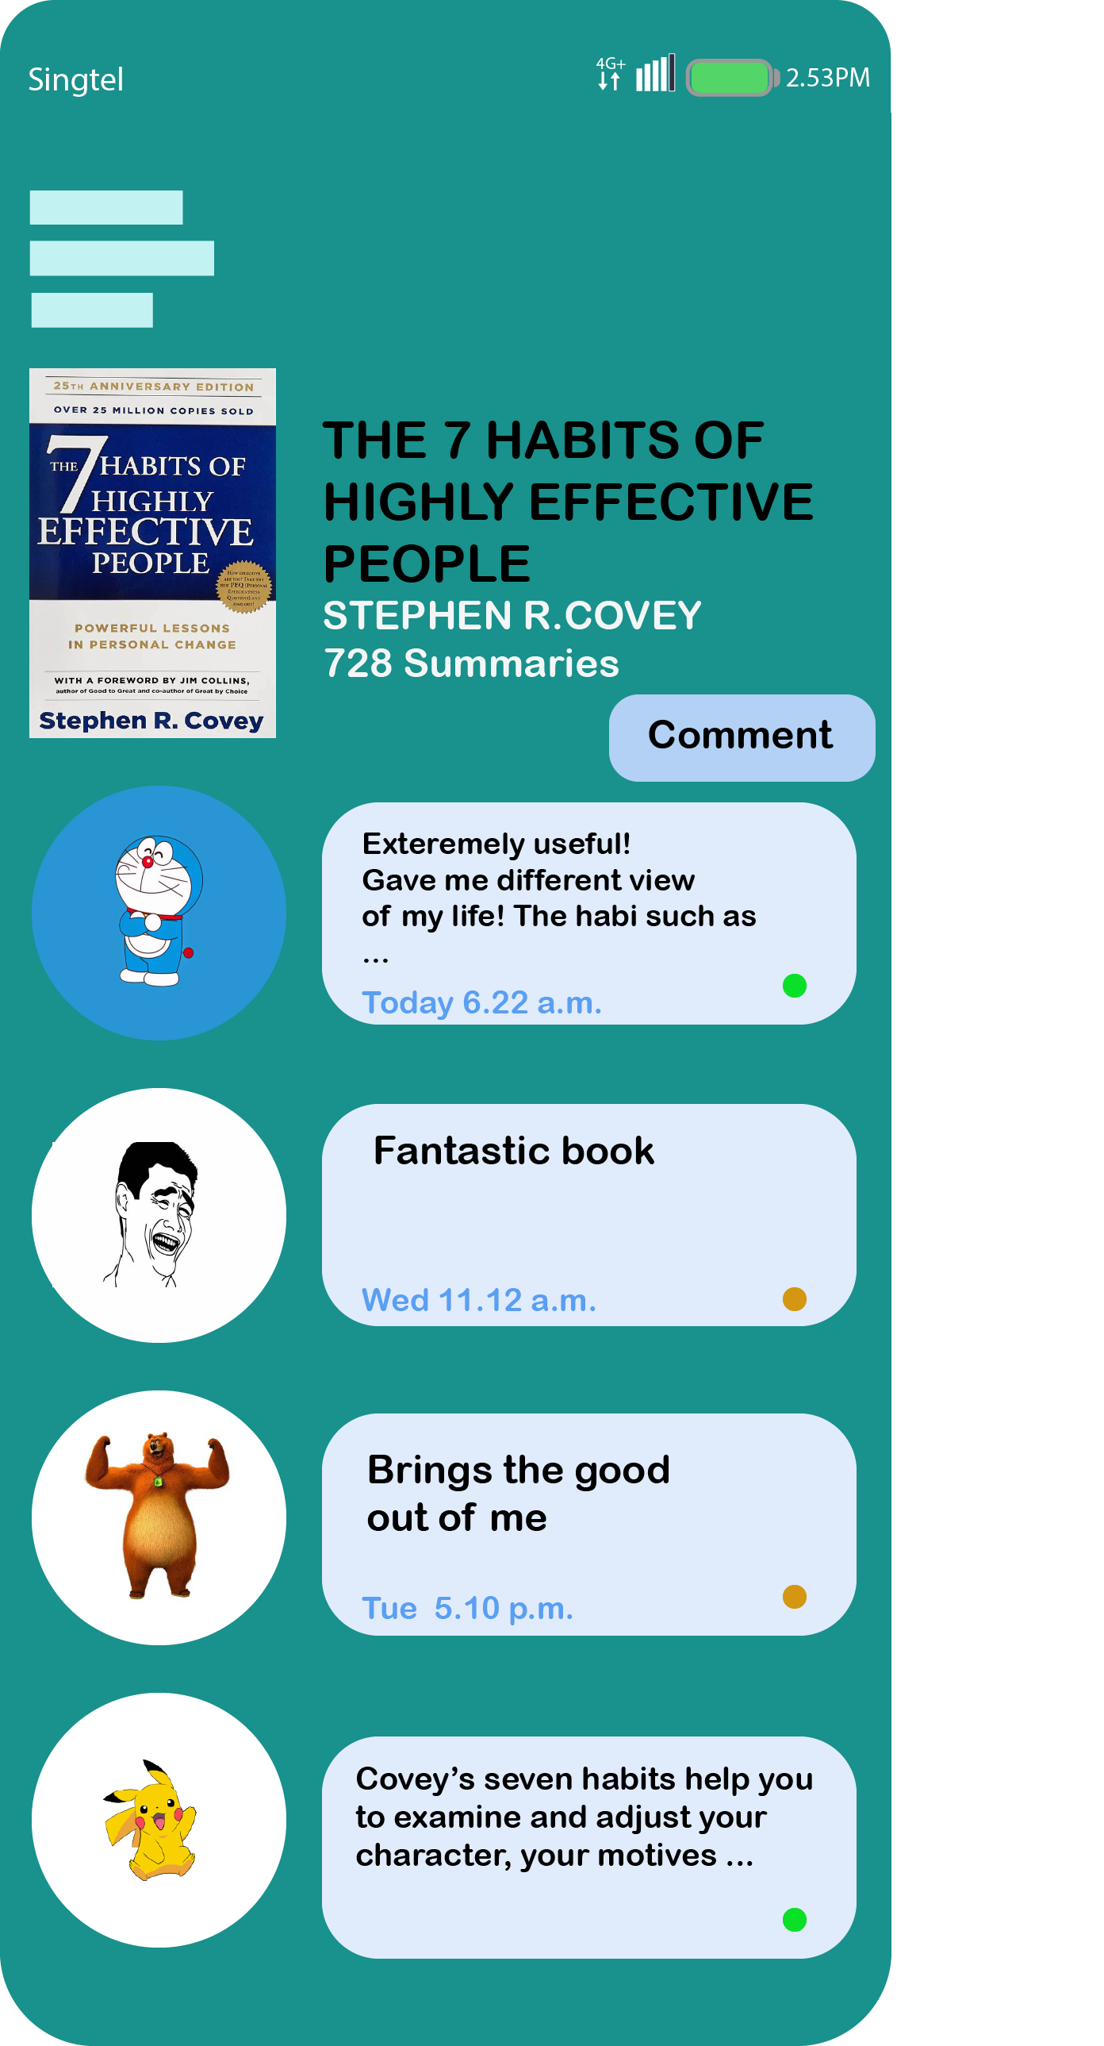
Comments of the Summaries

Slide 15
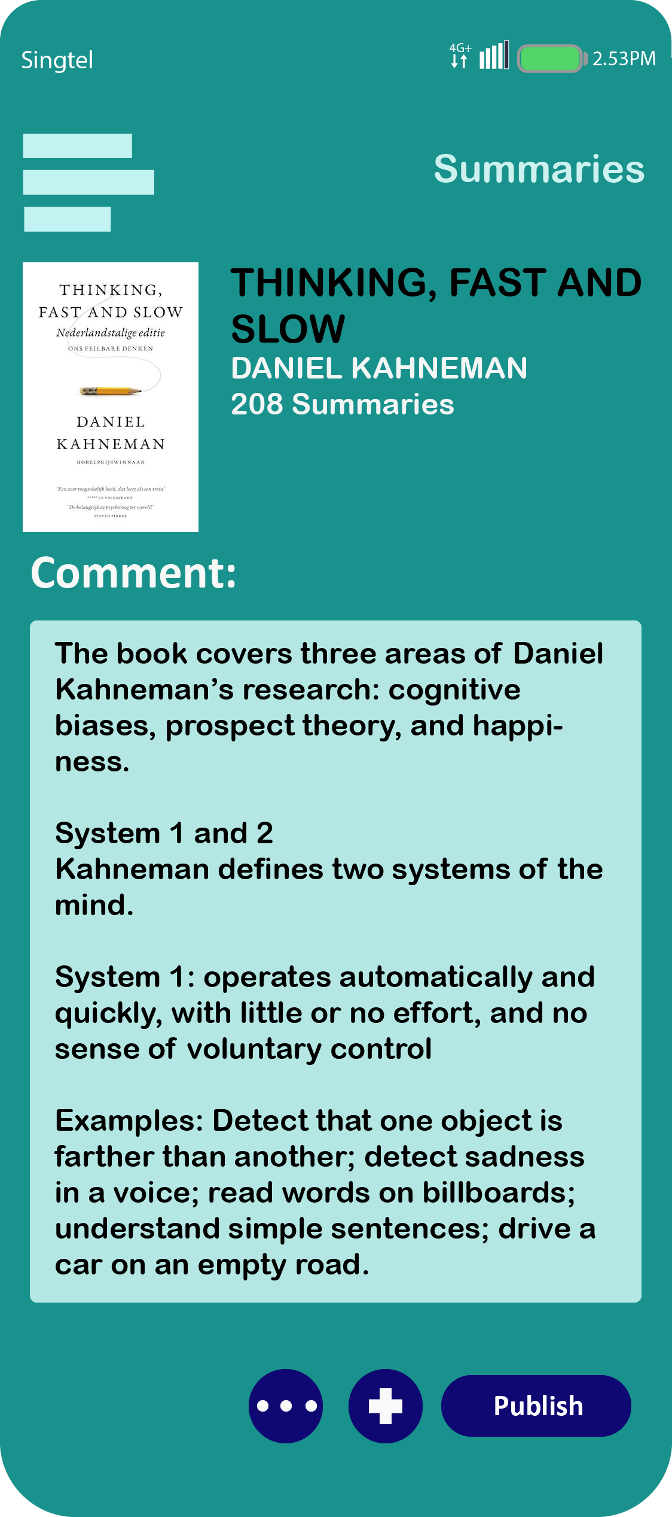
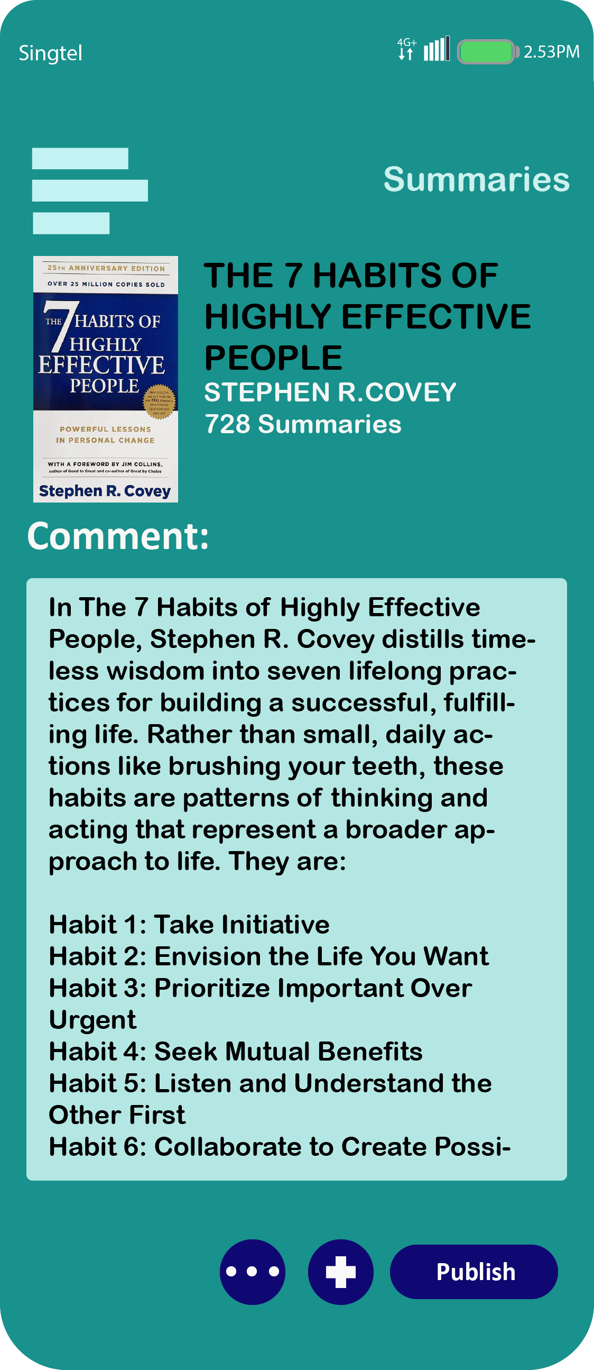
Publishing of Comments

Slide 16
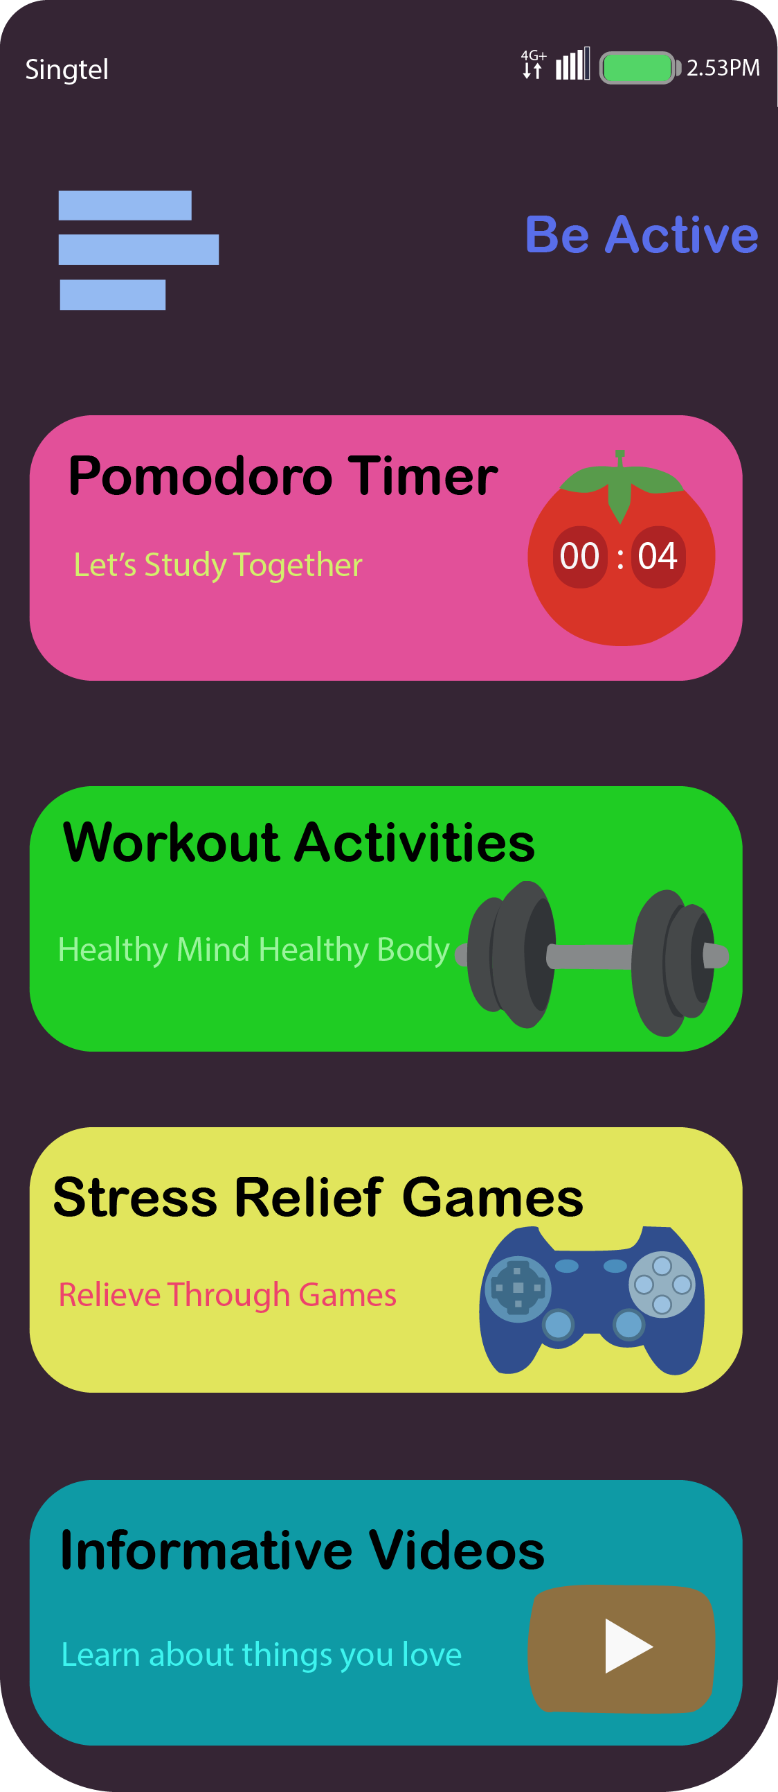
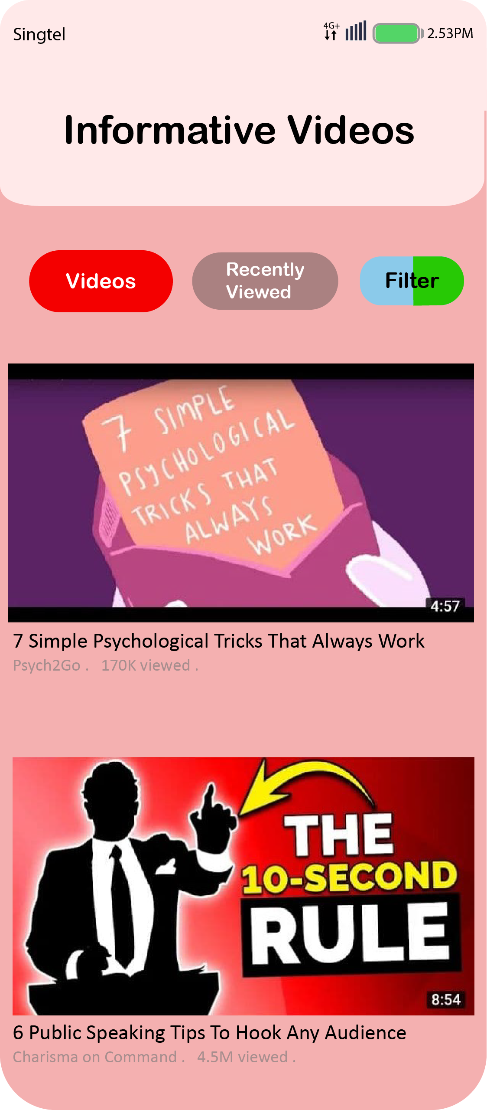
Functionalities

Slide 17
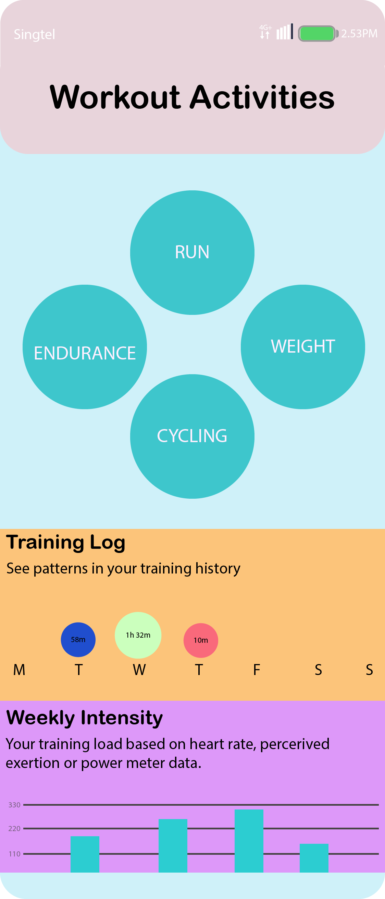
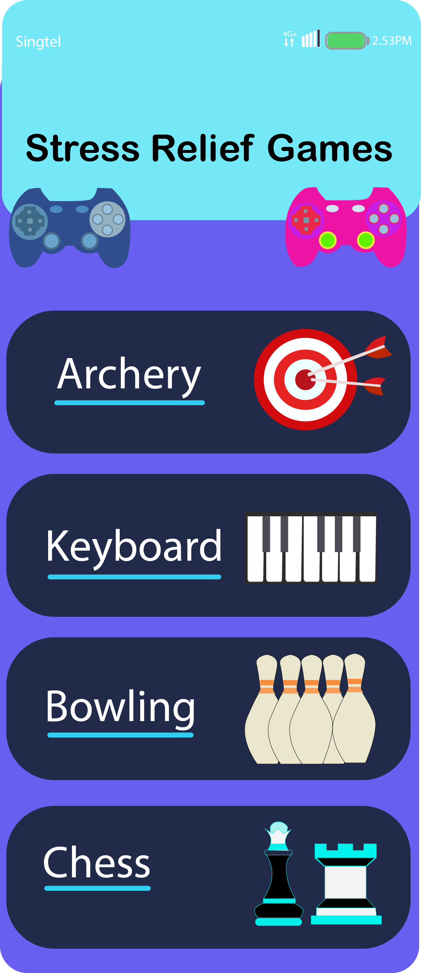
Functionalities

Slide 18
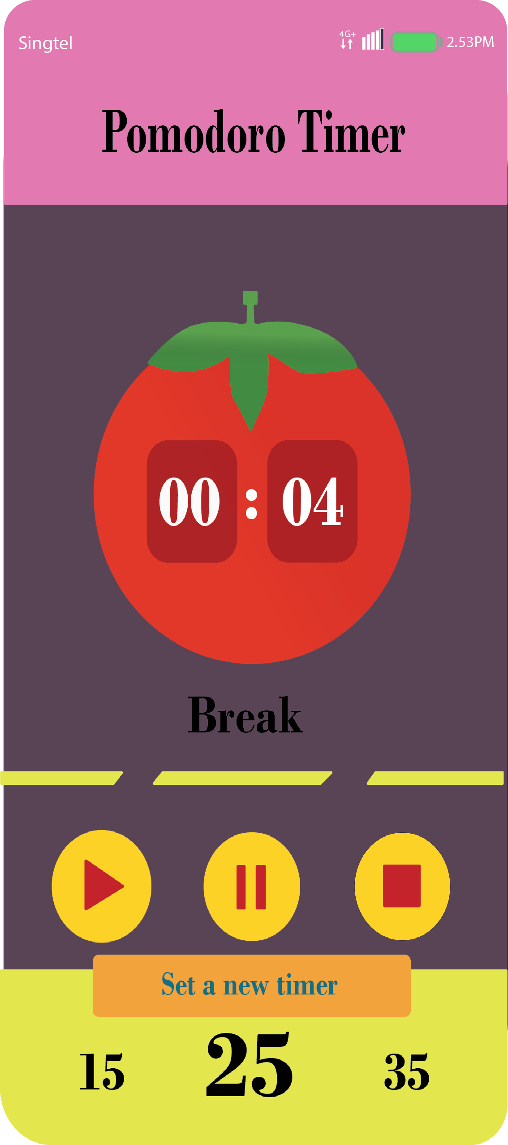
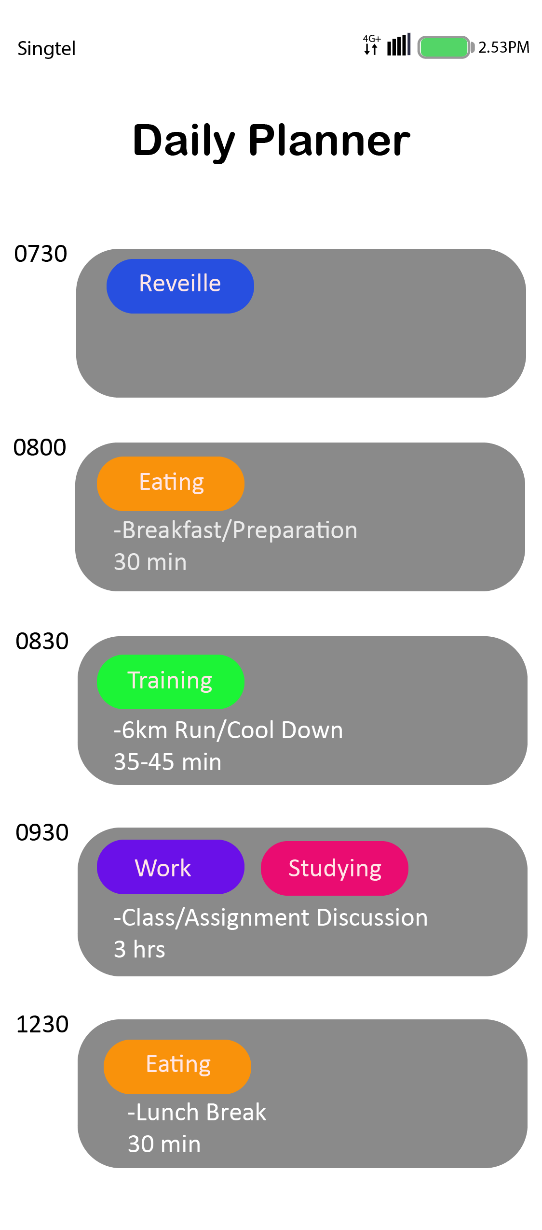
Functionalities

Slide 19
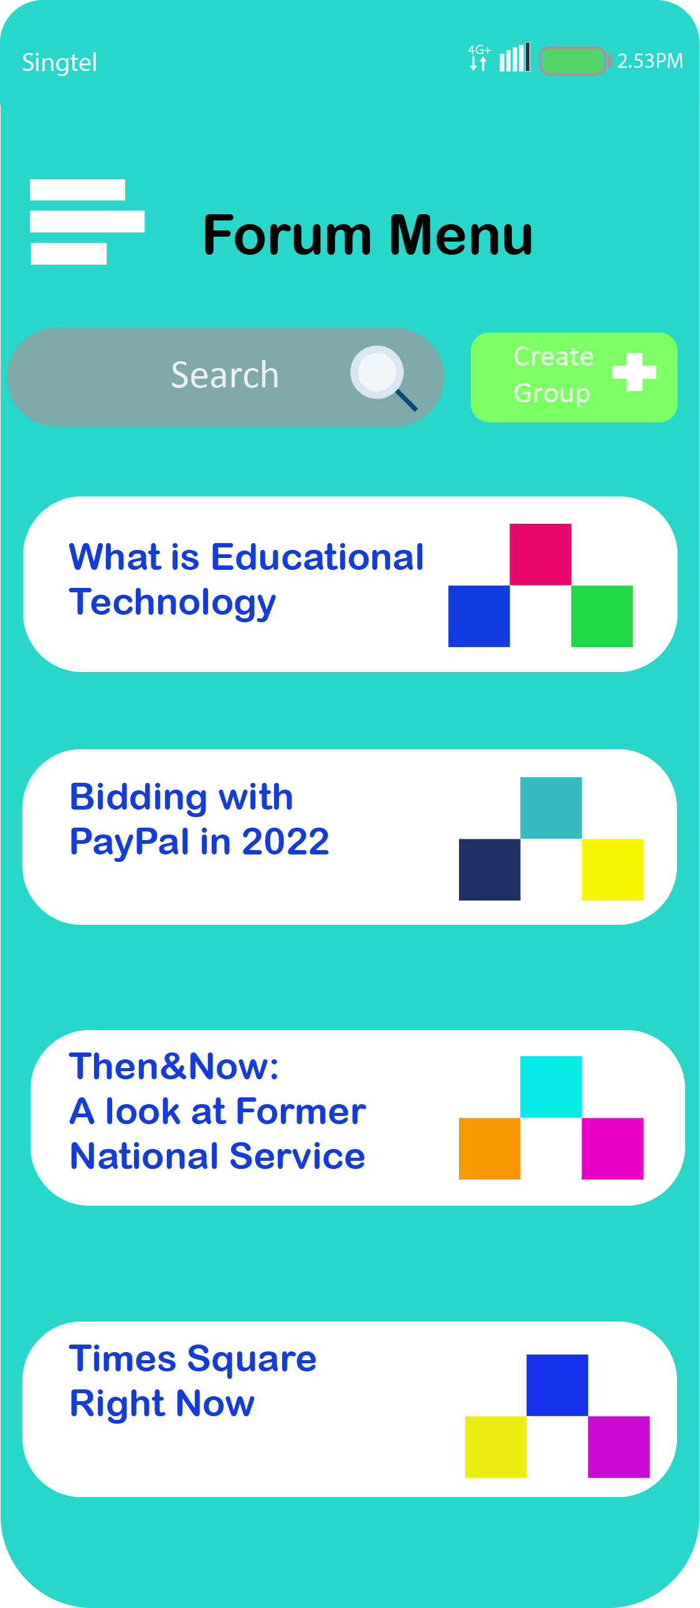
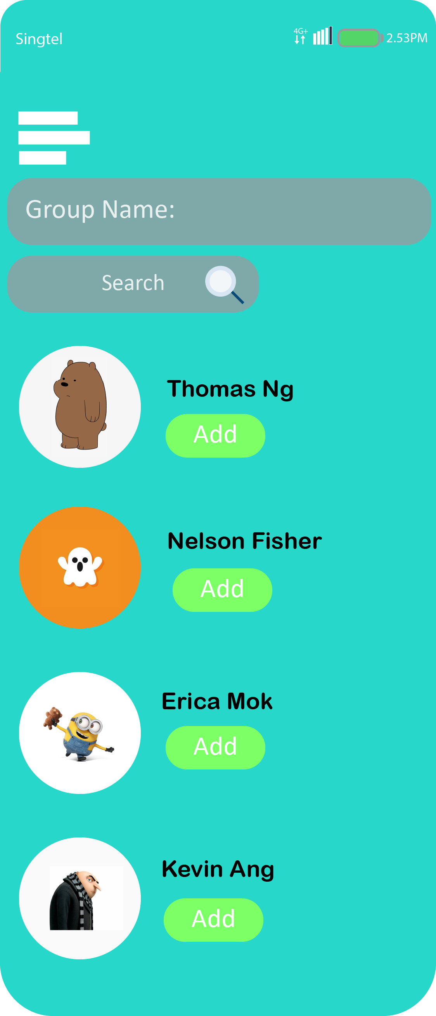
Discussion Forum

Slide 20
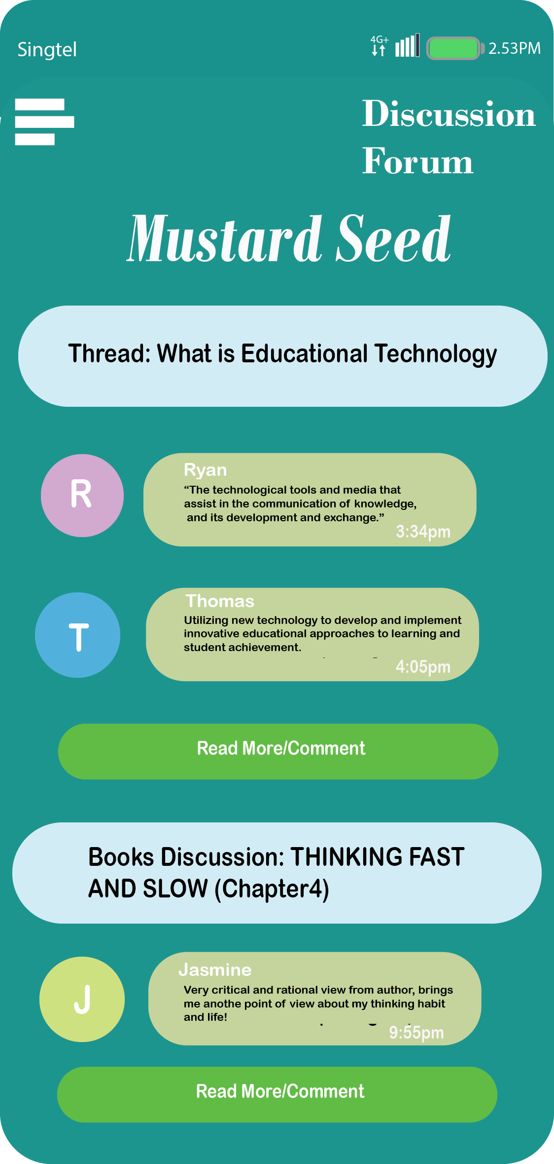
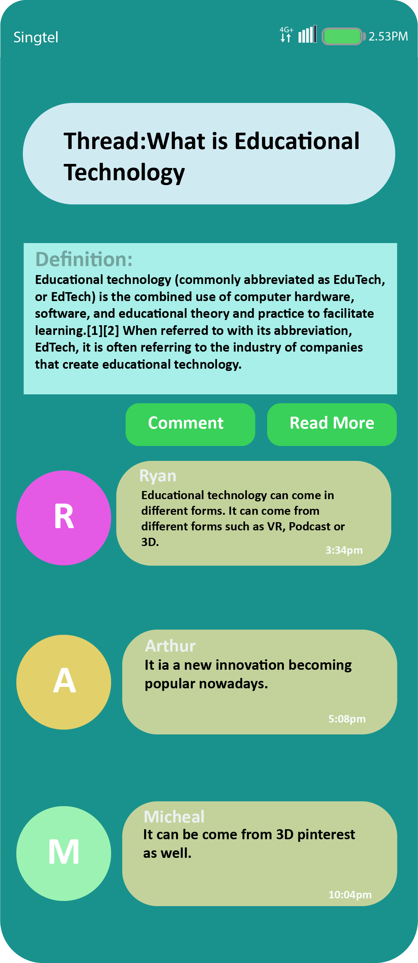
Discussion Forum Thread

Slide 21
Prototype Demo
https://xd.adobe.com/view/97014bd1-9188-4b41-af67-65c6585c60c9-c252/

Slide 22

Thank You

Slide 23
Q&A

